Slide 1

Text Summarization – A study in current Practices
MSBD 5014 - Project Proposal
Group Member:
BASUCHAUDHURI Priyanko (20723115)

Slide 2
Background
As fierce fighting continued across Ukraine on Monday, Kyiv said it would push for a cease-fire at talks with officials from Moscow.
The meeting on the Belarusian border comes after Russian President Vladimir Putin ordered his nuclear deterrent force to be on high alert, a huge escalation in Russia's confrontation with Western powers who have increased their supply of lethal aid to Ukraine and imposed crippling financial sanctions on Moscow.
The United States announced Monday morning it would ban all American businesses from dealing with Russia's central banks, as well as freezing the assets of a Putin associate.
Those sanctions were felt across Russia on Monday, as the value of the ruble went into freefall and Moscow's central bank raised interest rates from 9.5 percent to 20 percent to protect people's savings.
The meeting on the Belarusian border comes after Russian President Vladimir Putin ordered his nuclear force to be on high alert. Western powers have increased their supply of lethal aid to Ukraine and imposed crippling financial sanctions on Moscow. The ruble went into freefall and Moscow's central bank raised interest rates.

Slide 3

Motivations
Numerous applications – like News Feed , Mail Client , User Content understanding , Event Progression etc.
Specialized application for understanding of niche domain knowledge – like Law , Medicine or Academic Research summarization
Research area which encompasses both NLU and NLG

Slide 4
Brief Introduction
Extractive | Extracts from texts – retains original text’s semantic structures | Methods are centred around top k sentence selection TF/IDF based sentence scoring within documents , using top k. Using Language model (like BERT) to learn sentence representations and perform K node clustering Building document graphs – based on sentence representation (other nodes like latent topic can be introduced) – apply GNN based summarization.
Abstractive | Abstracts from text – generates new text | Methods are centred around Seq2Seq neural model training Build custom Encoder-Decoder model to summarize text Use large pre-trained general purpose language models(GPT2, BERT.. ) to train for summarization task Use large pre-trained language model specifically trained for text summarization (PEGASUS)

Slide 5
Comparisons
Extractive summarization preserves grammatical correctness – can be inflexible.
Extractive summarization based on sentence representation may be difficult on very long texts – augmenting it with latent topic and document graph can provide good representation of a long text.
Abstractive summarization is flexible – but can be prone to issues of NLG – like grammatical errors , entity hallucination.
Large pre-trained transformer model, specific for text summarization – PEGASUS achieves SOTA in most datasets.

Slide 6
Challenges
Validation of summarized texts
- ROUGE-n family can not check fluency , also adequacy measured based on overlapping n-gram
Cross domain text summarization
- Is a model trained / fine-tuned on News article data can effectively summarize User generated content ?

Slide 7
Objectives of Project
Produce a short survey on current practices and understand evaluation process through ROUGE-n and BLEU
Train text summarization models using following 2 approaches
Extractive summarization using a K centroid clustering from BERT sentence representation
Abstractive summarization using Google’s PEGASUS pre-trained model
Test the models with texts from different domains

Slide 8
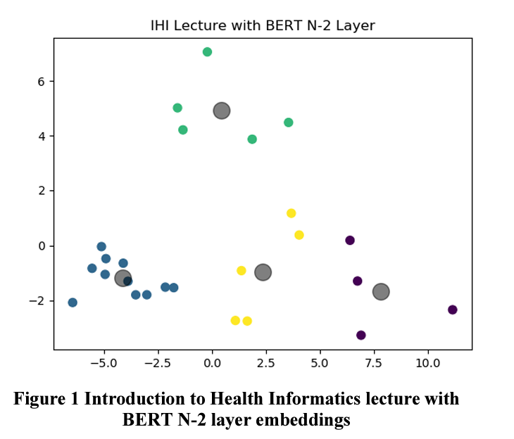
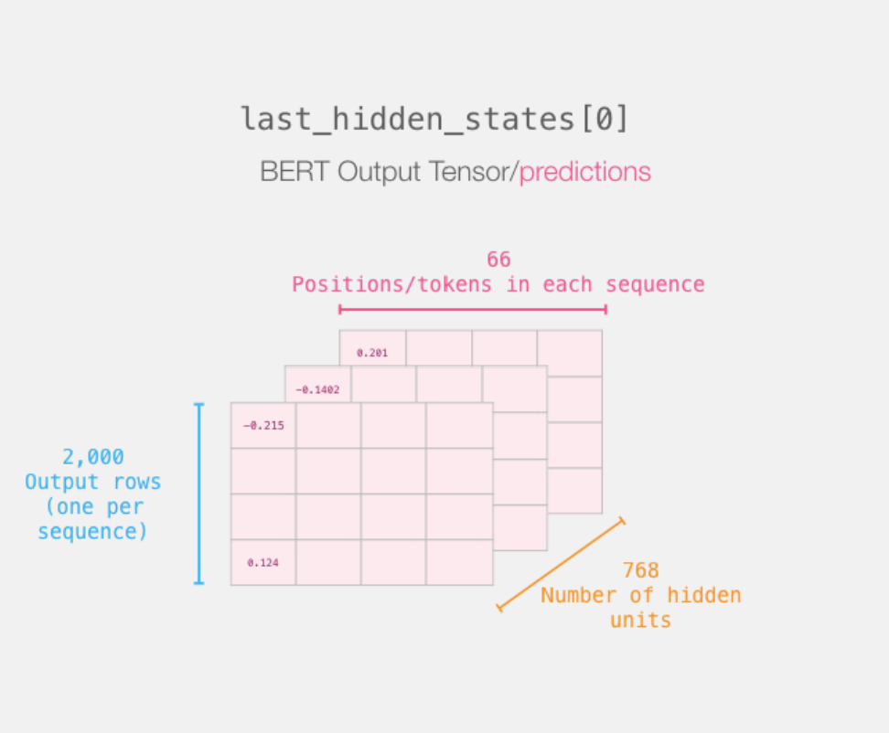
BERT based summarization
Training of BERT
Bi-Directional encoder stack reads the whole sequence of word tokens at once
Masked LM – masks 15% input words and trains for prediction of the words
Next sentence Prediction
Get Sentence embedding
Use orthogonal projection (PCA) on lower dimension
Apply clustering and use K centroids

Slide 9
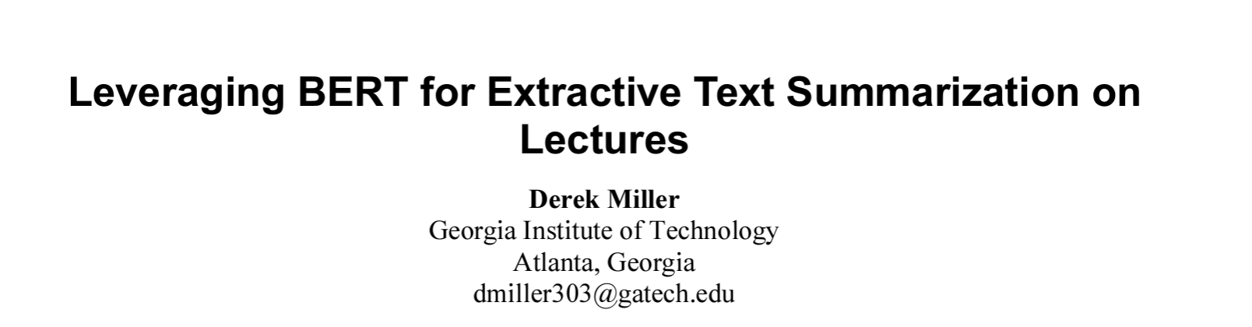
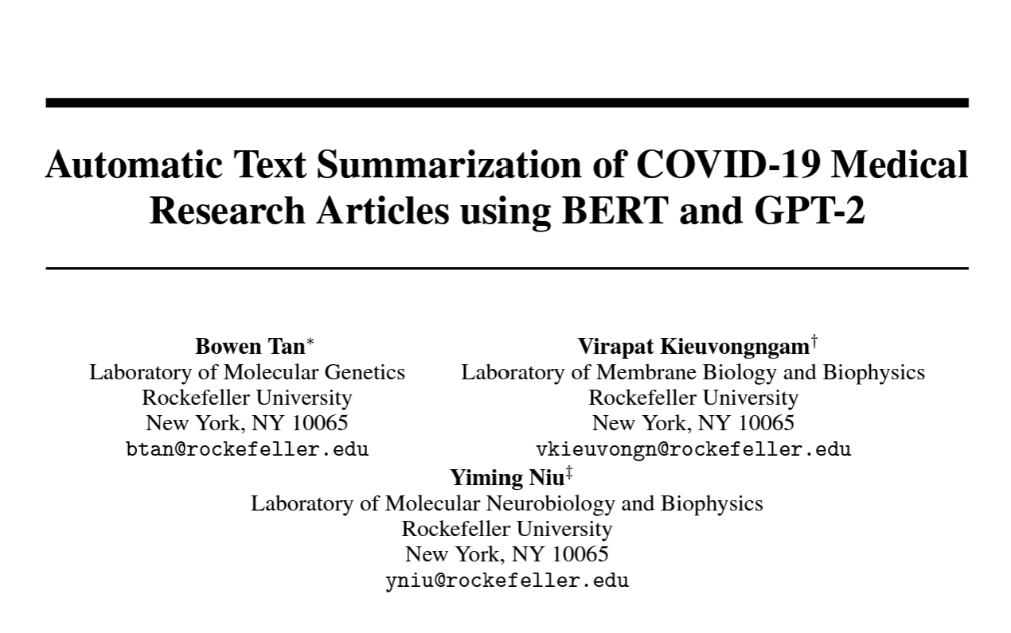
BERT based summarization
Interpretative Visualization
Use Pre-trained model of BERT to achieve good sentence embeddings

Slide 10
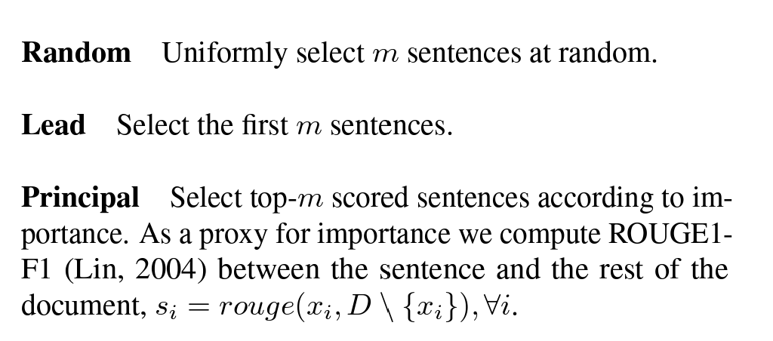
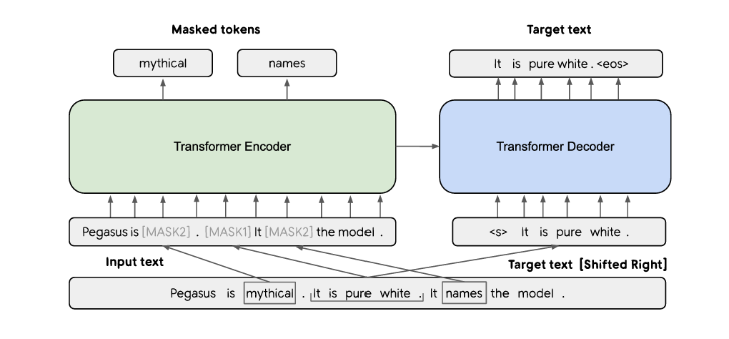
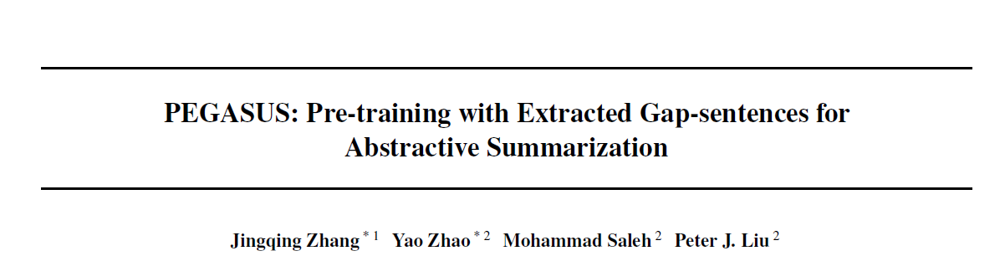
PEGASUS - Pre-training with Extracted Gap-sentences for Abstractive Summarization
Self supervised , Seq2Seq model for Abstractive summarization – trained on GAP sentences.

Slide 11



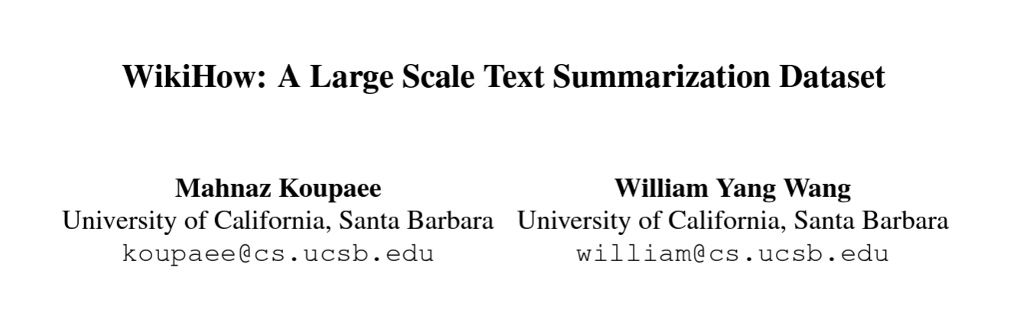
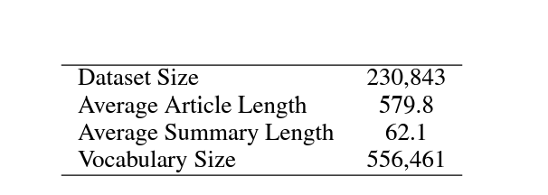
Technology Stack & Data
Finally test on samples from different domain – news , user created content , Reddit Post etc ..

Slide 12
Q&A
Thank You !

